Slide 1
Repeatability
Aneesh Batchu
October 5th, 2024

Slide 2
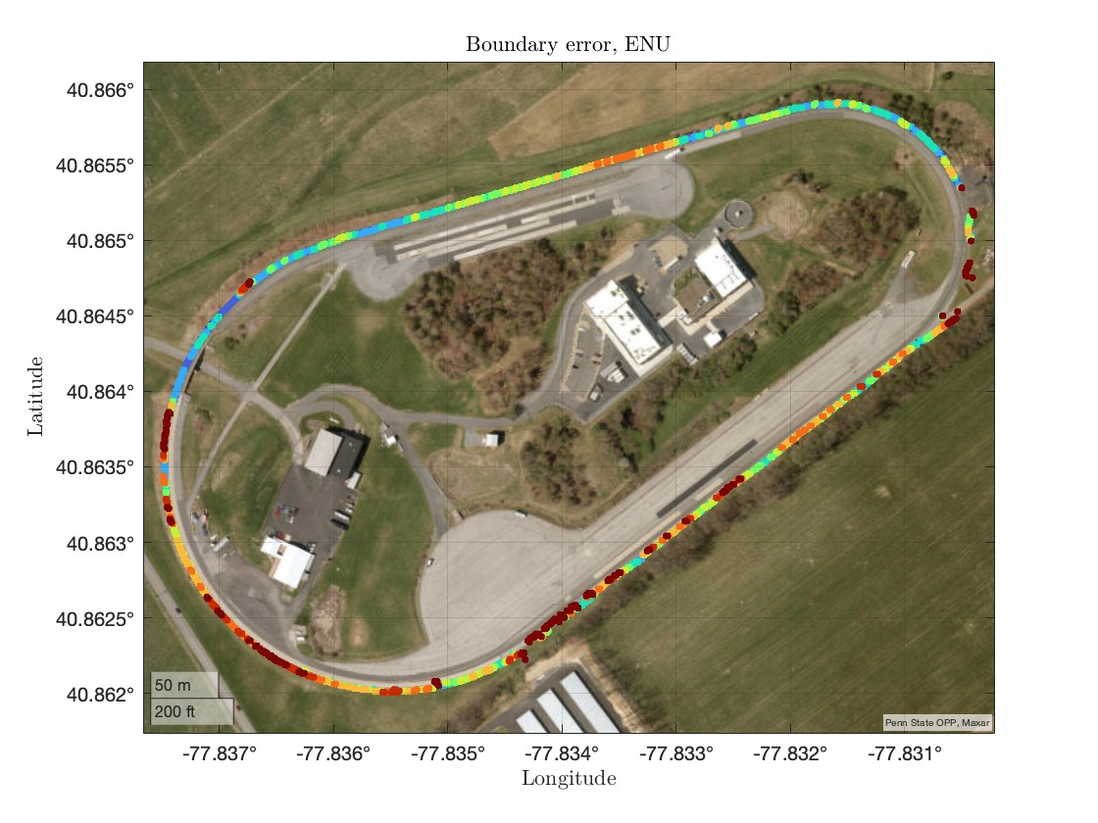
The histogram of the orthogonal distances from the hand-labeled points to computed boundary points is shown in the RHS. The LLA plot shows the test track with the computed boundary points classified based on the error magnitude. Red indicates a higher error, and blue indicates a lower error

Slide 3
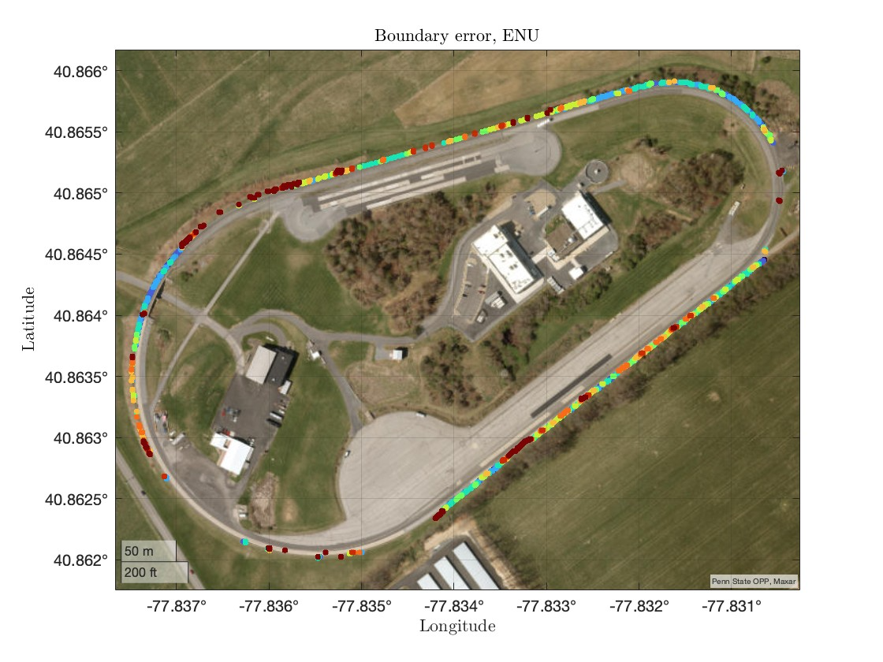
The histogram of the orthogonal distances from the hand-labeled points to computed boundary points is shown in the RHS. The LLA plot shows the test track with the computed boundary points classified based on the error magnitude. Red indicates a higher error, and blue indicates a lower error

Slide 4
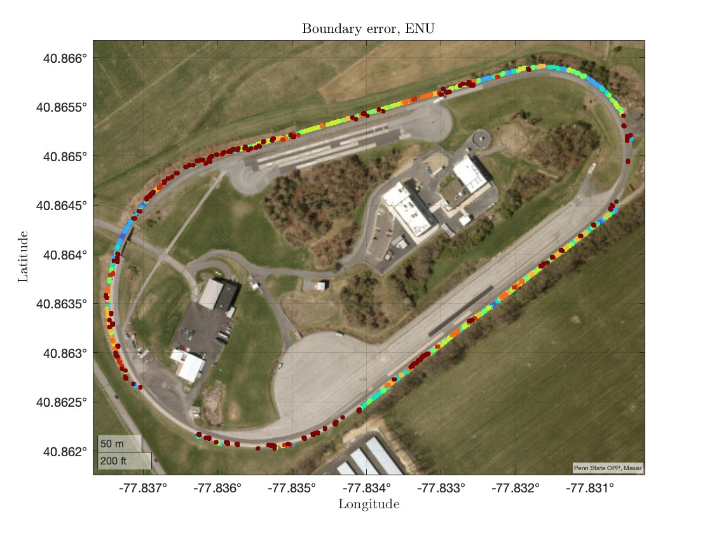
The histogram of the orthogonal distances from the hand-labeled points to computed boundary points is shown in the RHS. The LLA plot shows the test track with the computed boundary points classified based on the error magnitude. Red indicates a higher error, and blue indicates a lower error

Slide 5
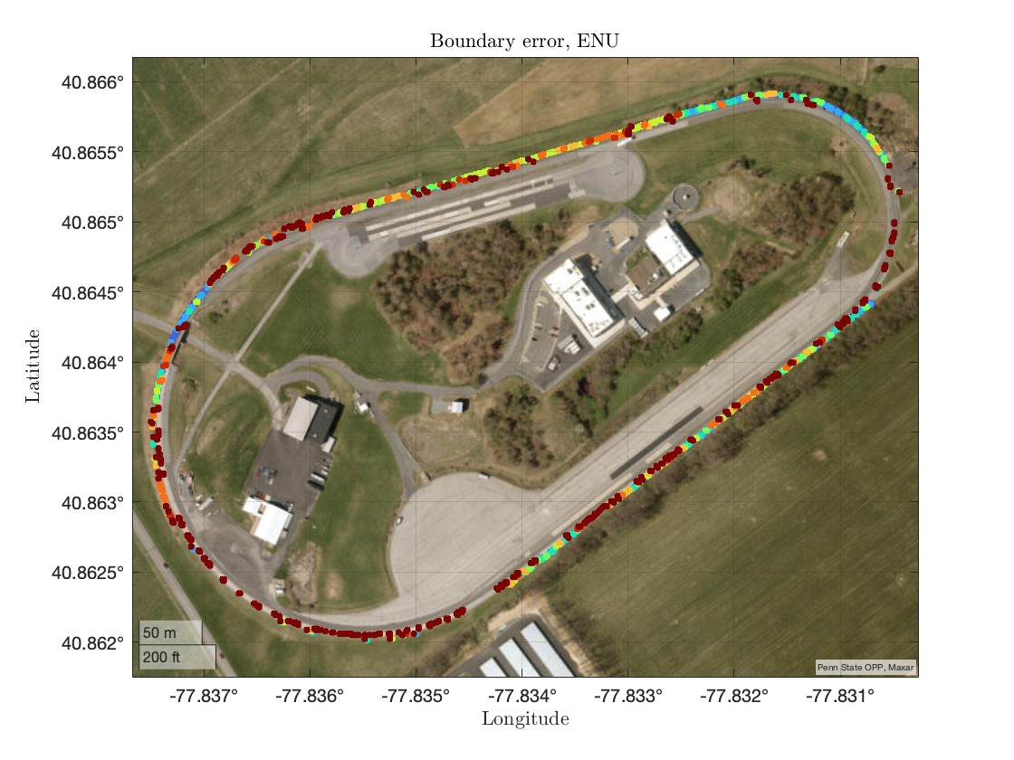
The histogram of the orthogonal distances from the hand-labeled points to computed boundary points is shown in the RHS. The LLA plot shows the test track with the computed boundary points classified based on the error magnitude. Red indicates a higher error, and blue indicates a lower error

Slide 6
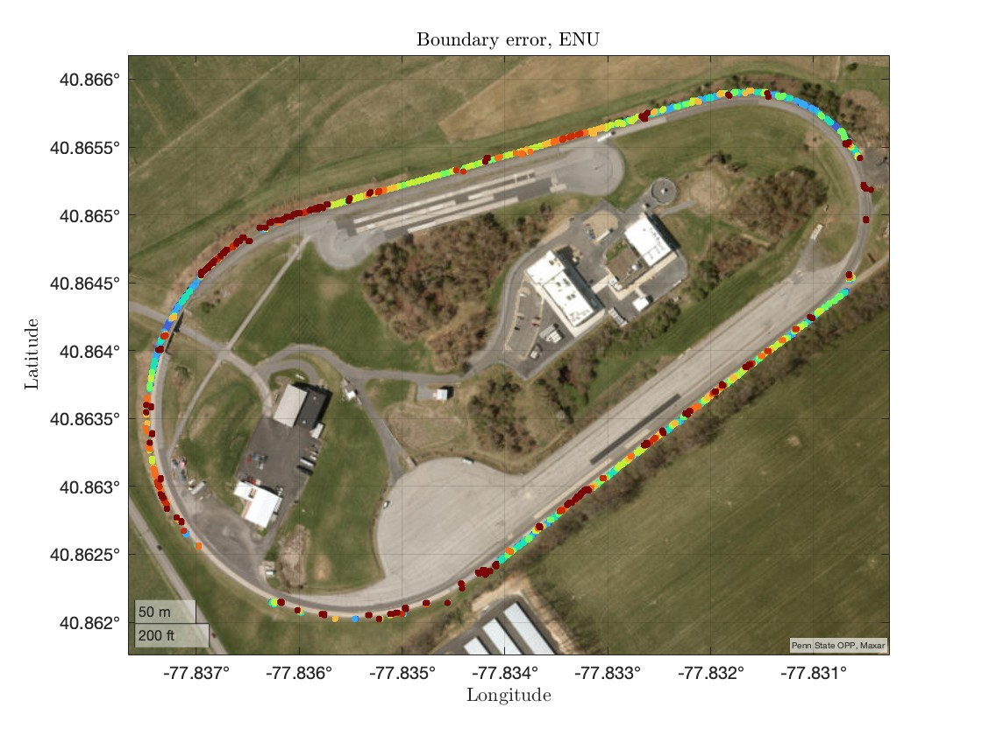
The histogram of the orthogonal distances from the hand-labeled points to computed boundary points is shown in the RHS. The LLA plot shows the test track with the computed boundary points classified based on the error magnitude. Red indicates a higher error, and blue indicates a lower error

Slide 7
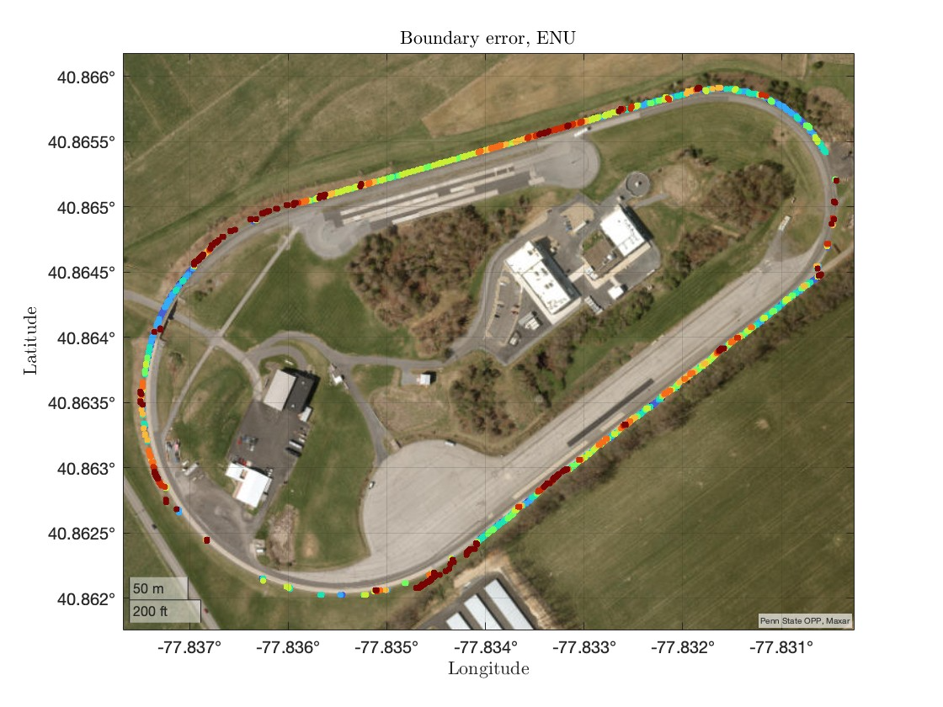
The histogram of the orthogonal distances from the hand-labeled points to computed boundary points is shown in the RHS. The LLA plot shows the test track with the computed boundary points classified based on the error magnitude. Red indicates a higher error, and blue indicates a lower error

Slide 8

The histogram of the orthogonal distances from the hand-labeled points to computed boundary points is shown in the RHS. The LLA plot shows the test track with the computed boundary points classified based on the error magnitude. Red indicates a higher error, and blue indicates a lower error

Slide 9
The standard deviation and mean of the orthogonal distances from the hand-labeled boundary points to computed boundary points for different test track runs
Run | Standard Deviation | Mean
Initial Run | 1.1646 | -0.2078
Run 1 | 1.1241 | -0.025
Run 2 | 1.4008 | 0.1969
Run 3 | 1.5391 | 0.6142
Run 4 | 1.2715 | 0.0314
Run 5 | 1.4406 | -0.3728
Run 6 | 1.3527 | -0.3913

